Slide 1
SIA Seminar Week 9: Session plan
Lecture recap
Mergers and Acquisitions (M&A) Paper critique activity (Paper 1)
M&A Paper critique activity (Paper 2)
M&A Paper critique activity (Paper 3)
Tip for writing a literature review part
Q&A

Slide 2
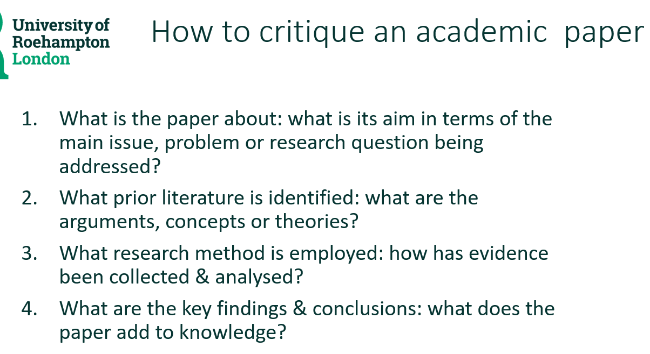
Lecture recap

Slide 3

Seminar Activity – share & apply
Read and prepare a critique of one of these:
Alexandradis et al. (2010) Gains from M&As around the world, FM, 1671-95
Antoniou et al. (2007) Bidder gains and losses of firms involved in many acquisitions? JBFA, 34(7): 1221 – 1244
Gregory (1997) An examination of the long run performance of UK acquiring firms, JBFA 24 (7): 0306-686X
Chase et al. (1997) A Suggested Ethical Framework for Evaluating Corporate Mergers and Acquisitions, JBE 16: p1753–1763

Slide 4
Paper 1. Alexandridis et al.(2010) abstract
Title: Gains from Mergers and Acquisitions Around the World: New Evidence Using a global M&A dataset, this paper provides evidence that the empirical observations relating public acquisitions to, at best, zero abnormal returns, and their stock-financed subset to negative abnormal returns for acquiring firms around the deal announcement are not unanimous across countries. Acquirers beyond the most competitive takeover markets (the United States, United Kingdom, and Canada) pay lower premia and realize gains, while share-for-share offers are at least non-value-destroying for their shareholders. In contrast, target shareholders within these markets gain significantly less, implying that the benefits generated are more evenly split between the involved parties.

Slide 5
Question | Paper (insert citation, showing author(s), date)
What is the paper about: what is its aim in terms of the main issue, problem or research question? | This paper provides evidence that the empirical observations relating public acquisitions to abnormal returns for acquiring firms.
What prior literature is identified: what are the arguments, concepts or theories?
What research method is employed: how has evidence been collected & analysed? | Using a global M&A dataset (to measure abnormal gains) around the deal announcement across countries
What are the key findings & conclusions: what does the paper add to knowledge? | Acquirers beyond the most competitive takeover markets (the United States, United Kingdom, and Canada) pay lower premia and realize gains, while share-for-share offers are at least non-value-destroying for their shareholders. In contrast, target shareholders within these markets gain significantly less

Slide 6
Question | Paper (insert citation, showing author(s), date)
What is the paper about: what is its aim in terms of the main issue, problem or research question? | This paper provides evidence that the empirical observations relating public acquisitions to abnormal returns for acquiring firms.
What prior literature is identified: what are the arguments, concepts or theories? | Billett and Qian (2008) argue that fierce competition for listed targets is likely to enhance managerial hubris-related effects. Agency problems discussed by Jensen (1986, 2005) Rossi and Volpin (2004), document that premiums are persistently higher in the United States and the United Kingdom, cited p.1671-2.
What research method is employed: how has evidence been collected & analysed? | Using a global M&A dataset (to measure abnormal gains) around the deal announcement across countries - sample of acquisition announcements from Thomson Financial SDC global M&As database and covers 13,226 deals in the period from 1990 to 2007, p. 1673-4.
What are the key findings & conclusions: what does the paper add to knowledge? | Acquirers beyond the most competitive takeover markets (the United States, United Kingdom, and Canada) pay lower premia and realize gains, while share-for-share offers are at least non-value-destroying for their shareholders. In contrast, target shareholders within these markets gain significantly less

Slide 7
Antoniou et al. (2007) Bidder gains and losses of firms involved in many acquisitions? JBFA, 34(7): 1221 – 1244
We examine shareholders' wealth effects (both in the short- and the long-run) of UK frequent bidders acquiring public, private, and/or subsidiary targets with alternative methods of payment between 1987 and 2004. We find that, in the short-run, bidders break even when acquiring public targets and gain significantly when buying private and subsidiary targets. This result is robust after controlling for relative size, bidder's book-to-market ratio, target origin, and industry diversification. Our long-run evidence, however, reveals that acquirers experience, significant wealth losses regardless of the target type acquired, indicating that markets may initially overreact to the acquisition announcement. As a result, we argue that contrary to Fuller et al. (2002) who suggest that acquiring private and subsidiary firms creates value for bidding firms, a reliable conclusion on bidders' shareholders wealth effects cannot be based solely on a short-run event study. http://dx.doi.org/10.1111/j.1468-5957.2007.02012.x

Slide 8
Gregory (1997) An examination of the long run performance of UK acquiring firms, JBFA 24 (7) https://onlinelibrary.wiley.com/doi/abs/10.1111/1468-5957.00146
This study examines a comprehensive data set of large domestic takeovers by UK listed companies between 1984 and 1992. The contribution of this paper is to show, by using a series of models of abnormal returns, together with the Ibbotson (1975) ‘Returns Across Time Series’ model and a simple cross‐sectional model of returns across all listed UK companies, that the average abnormal return for up to two years post‐acquisition is unambiguously and significantly negative. In particular, acquirers financing a takeover through equity, and single (as opposed to regular) acquirers exhibit significant negative performance. There is also some evidence to suggest that diversifying acquirers perform worse than non‐diversifying acquirers and that recommended bids are associated with poorer subsequent under‐performance by acquirers than are hostile bids.

Slide 9
Chase et al. (1997) A Suggested Ethical Framework for Evaluating Corporate Mergers and Acquisitions, JBE 16: p1753–1763
The 1980s witnessed a dramatic increase in hostile takeovers in the United States. Proponents argue that well-planned mergers enhance the value of the firm and the value of the firm to society. Critics typically argue that undesired takeovers ultimately harm society due to external costs not borne by the acquiring firm. To be socially responsible, the manager must consider the effects of the merger/acquisition on all stakeholders. Different traditional ethical frameworks for decision making are proposed and reviewed. A model is proposed.
https://doi.org/10.1023/A:1005794127954

Slide 10
Tips: Writing a literature review part
Example: Harris et al., 2016 (Week 8 paper 4 P.1180)
From broader setting to a specific article
Chronologically
How to find relevant and reliable literature
Reading list
Key journals
Business source premier/ Emerald Insight

Slide 11

Any questions? (on activities or the assessment brief)

